Slide 1
Information Session Household Support Fund Discretionary Energy Rebate Scheme The Lancaster District Hardship Fund

Slide 2
Household Support Fund 2 April – Sept 2022
£555,000 allocated to Lancaster City Council
Third of allocation to be spent on Pensioners:
£90 will be sent out via Post Office vouchers
Just under 4,000 households receiving Council Tax Support (c: £360,000 spend)
Vouchers due to be sent from mid July 2022 to eligible households
Lancaster District Food Justice Partnership:
Just over £150,000 to support food provision to vulnerable households via Food Clubs, Banks and Pantries via Eggcup
Additional details later in presentation

Slide 3
Discretionary Energy Rebate Scheme
£299,700 of funding to support households who:
Didn’t receive the £150 statutory energy rebate
Provide a discretionary top-up payment
The following eligibility criteria has been approved:
CTAX bands E-H on CTAX support £150 payment
CTAX bands A-D on full CTAX support £30 top-up
CTAX bands A-D on some CTAX support with children under 5 £30 top-up
SMI in CTAX bands A-D £30 top-up, CTAX bands E-H irrespective of CTax support £150
Disabled Persons Allowance: Bands A-E: (Higher band due to the band reduction) £30 top up, in bands F-H £150

Slide 4
Discretionary Energy Rebate Scheme
Estimated spend around £300,000
Only one top up payment per household will be made
Leftover funding: We will consider any requests we have received from people who have missed out on the statutory scheme; however funds will be extremely limited
Funds need to be spent by 30th November 2022
Live date end of July 2022
All payments will be made via Post Office voucher letter
Resident Support Officer team will help residents who are struggling to cash their voucher and a dedicated phone line has been set up for all of the grants (01524 582000 press option 7). This line is due to go live on 1st July 2022

Slide 5
Lancaster District Hardship Fund
£347,000 left from the Council Tax Hardship Fund that ran at the start of the pandemic
Building on lessons learnt from Emergency Assistance Grants (EAGS) and Household Support Fund (round 1)
Provide longer term support to residents
Citizens Advice North Lancashire and Eggcup to provide details of the partnerships developed to support residents and the essential roles they will play
This fund can help with:
Utility Bills
Food
Debts
Housing costs as well as household appliances and other essential items

Slide 6
Lancaster District Hardship Fund
Short online application
Self complete form or a friend or third party can do on the residents behalf
Resident Support Officers (RSO’s) can also complete the form via our dedicated phone line or at any of our face to face Community Hub Locations
Once submitted, an RSO will contact the resident and book them an appointment with Citizens Advice
Text message reminder of appointment time and date; details passed to Citizens Advice
Any essential items that are required after an assessment with Citizens Advice has been carried out will be awarded by the RSO’s

Slide 7
Lancaster District Hardship Fund
Capacity:
Recently recruited 3.5 full time workers
All new staff are undergoing training and expect capacity to build quickly to approximately 80-85 cases per week
Reporting:
Citizens Advice will capture how residents have been supported the advice provided, to include:
Housing Advice
Debt work
Income gained through the Hardship Fund and benefit assessments

Slide 8
Lancaster District Hardship Fund
What our advisors will do as part of the assessment:
Debt Assessment and Benefit Check that identifies debts and unclaimed entitlements to maximise income
Emergencies such as: possession claims; imminent evictions, bailiff enforcement immediate holding strategy to ask for more time to work with client
Income and Expenditure detailed on draft financial statement
Requests to the Hardship fund for short term support
Follow up appointment as and when required

Slide 9
Lancaster District Hardship Fund – Eggcup
Money provided from the Household Support Fund (round 2)
Through the buying co-op this will support over 1600 household each week by increasing the amount of food available via the foodbanks, clubs, pantries and community meals
We buy in bulk to get discounts, working together everyone benefits
Aiming for savings of 30% against retail prices
During Household Support Fund (round 1)
Spent £145,168 on food
Total weight of food: over 65 tonnes
Total savings against retail price: £137,500 (51.3% of the retail price)

Slide 10
Lancaster District Hardship Fund – Eggcup
Temporary membership scheme offers 8 weeks free Eggcup membership
This provides each household with between £25-£30 of food each week
500 places available
Participants of the scheme can choose to continue their Eggcup membership after the 8 weeks at a cost of £5 per week

Slide 11
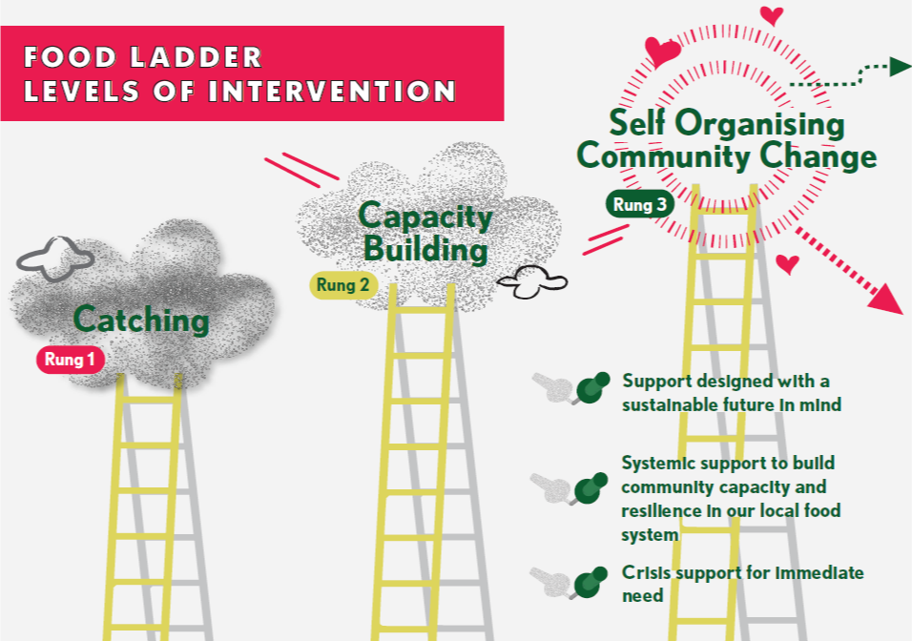
Lancaster District Hardship Fund: A Food Ladders Approach
Rung 3
We aim to have an empowered community that independently designs and develops new food projects
Rung 2
We stimulate interest and build on people’s abilities, providing a framework of support to allow people to build confidence and capacity
Rung 1
We make sure our safety net is robust and complete to catch people falling into crisis
Dr Megan Blake, University of Sheffield
https://geofoodie.org/2019/06/19/food-ladders/

Slide 12
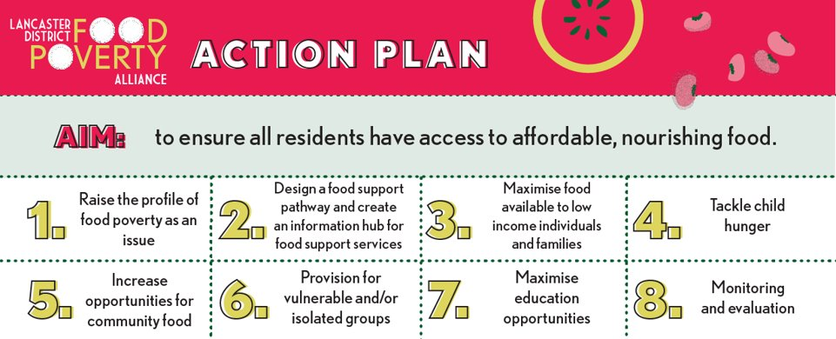
Lancaster District Hardship Fund: A Food Ladders Approach

Slide 13
Lancaster District Hardship Fund
Grant is due to go live Monday 4th July 2022.
Any Questions?

